Slide 1




ConcernedCitizens of
Wallace-Mapleton
Est. August 15, 2016

Slide 2
Concerned Citizens of
Wallace- Mapleton
Join us in making a difference in our community.

Slide 3
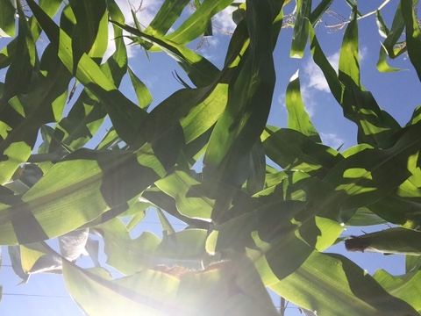

Slide 4
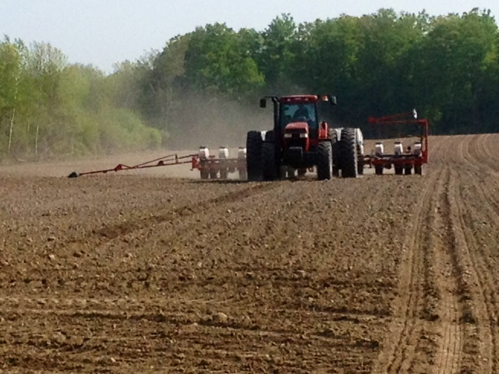

Slide 5
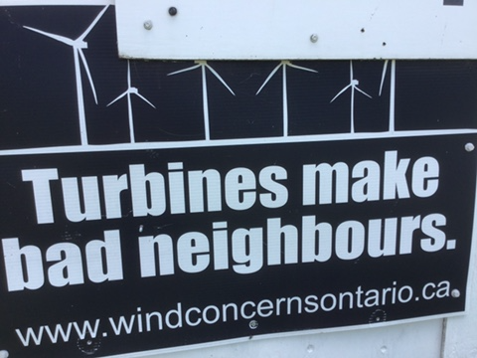

Slide 6
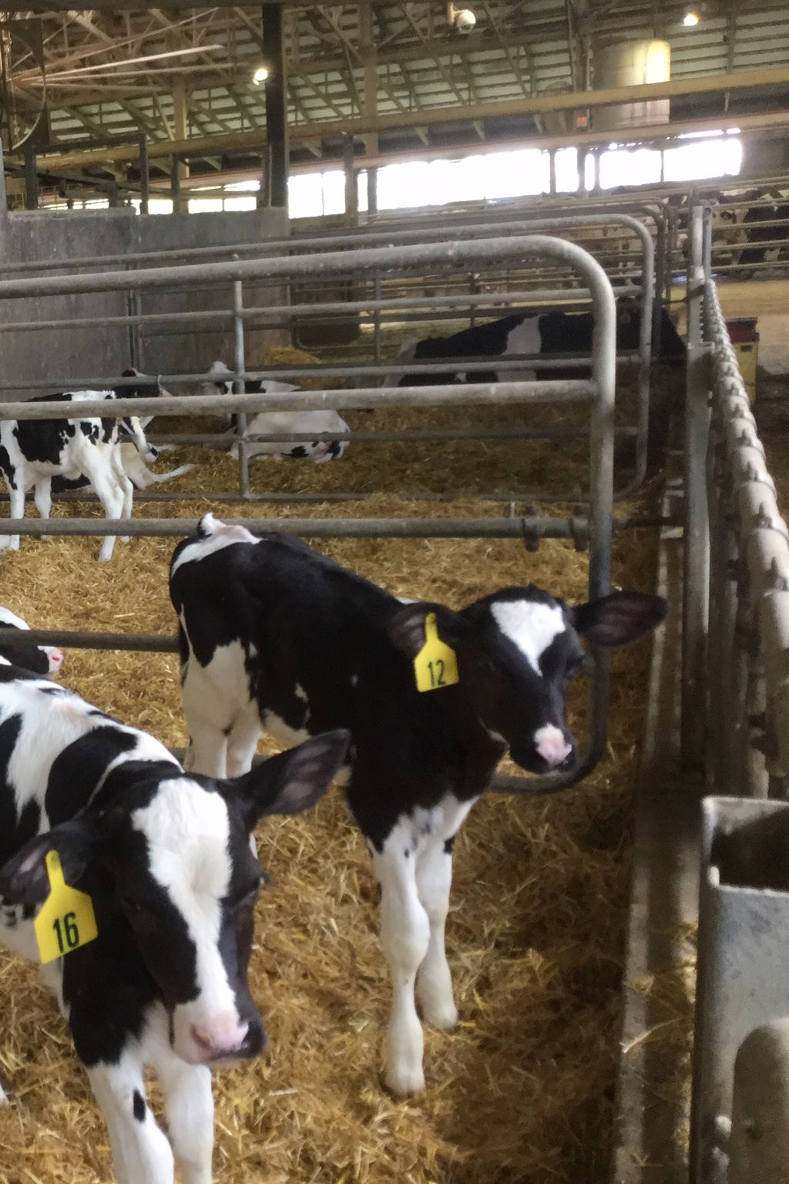

Slide 7
ConcernedCitizens of
Wallace-Mapleton
We have 2 main goals…

Slide 8
Goal #1
ConcernedCitizens of
Wallace-Mapleton
While being grounded in our rural and agricultural roots, our goal is to create the best conditions for our community to reach its highest potential.

Slide 9
Goal #2
ConcernedCitizens of
Wallace-Mapleton
We will strive to protect our land and the freedom to prosper and live in a healthy environment.

Slide 10
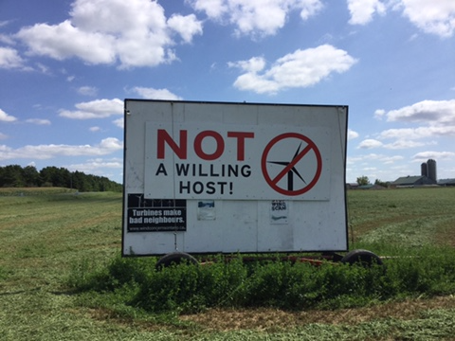

Slide 11
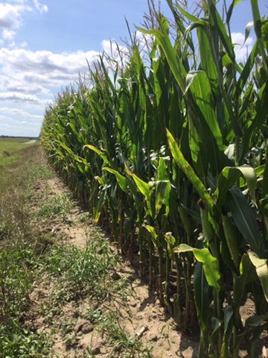

Slide 12
To reach our goals….
It will take more
than one family…

Slide 13
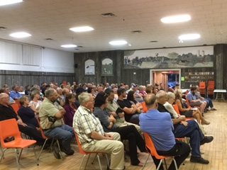
200 concerned citizens attended a meeting on Aug. 24, 2016 in Listowel to learn about the impact of Wind Turbine Projects.

Slide 14
It will take more than ONE community…..

Slide 15
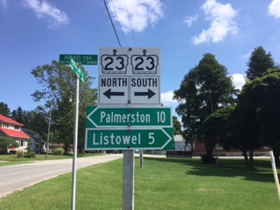

Slide 16
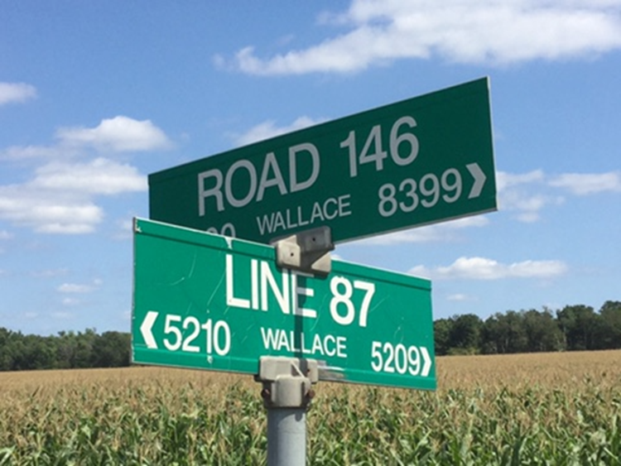

Slide 17
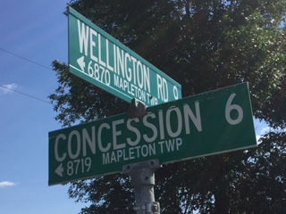

Slide 18
It will take a collective effort of all of us to make a difference…

Slide 19
Do you believe you can make a difference

Slide 20
How can you help?

Slide 21
Help with the little things…
Volunteer your time to set up for meetings, deliver newsletters, sell signs & take or deliver the sign trailer.

Slide 22
We appreciate all the things you do…
(big or small)
to support our community.

Slide 23
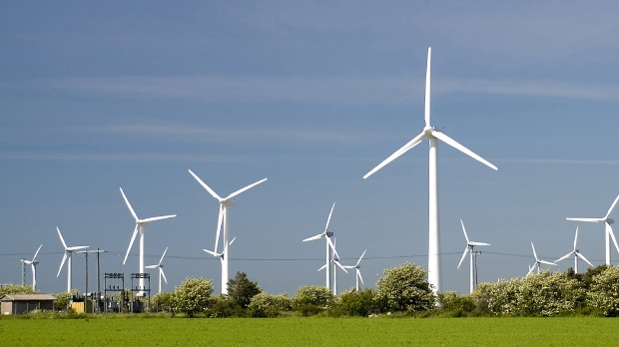
You need to decide if you want this

Slide 24
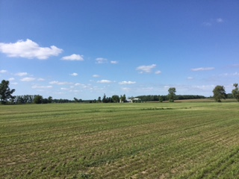
OR Do you want to KEEP this

Slide 25
It is not too late to
make a difference!
Contact us if you want to
be involved.
douga@cyg.net

Slide 26
WE are all busy… but busy people get things done!
There is never enough time
it seems…
BUT, now is the time
to make a difference.

Slide 27
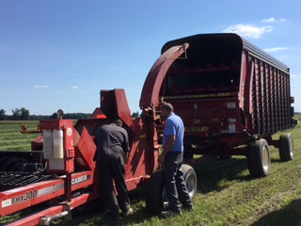

Slide 28
There is one thing
everyone can do...

Slide 29
Seek advice, do your research, and consider the impact of your decisions on the well-being of you
& OUR community.

Slide 30

Our community efforts at the public meeting have resulted in the creation of an executive team for
Concerned Citizens
of Wallace-Mapleton

Slide 31

The public meeting also reached out to inspire over 20 people to step up and be on a general committee to do the
little things.

Slide 32
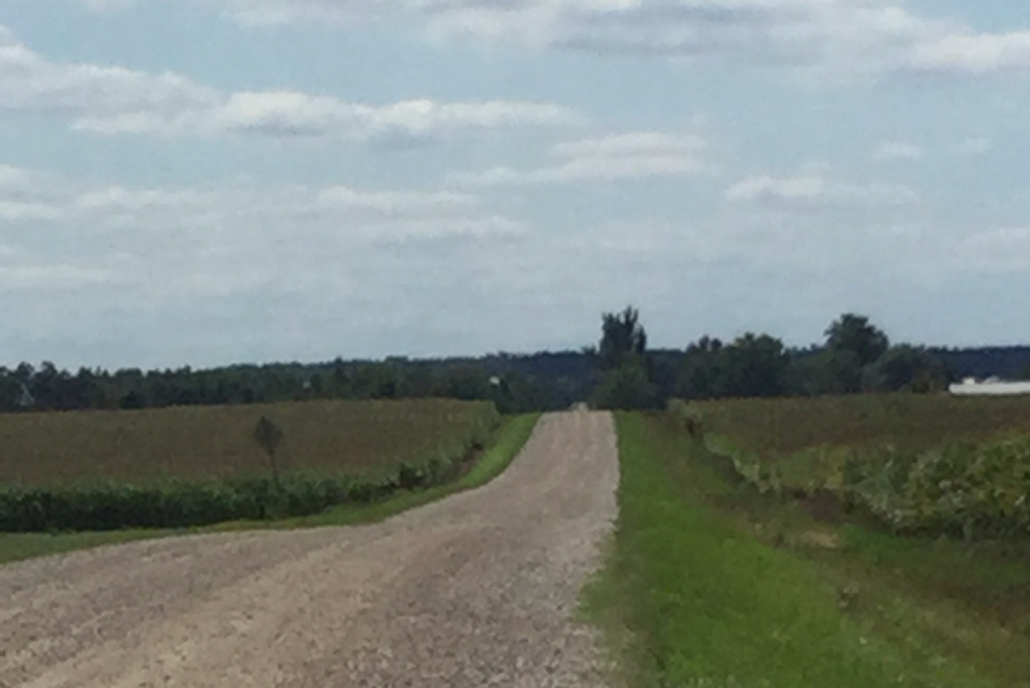
Thank you for taking this route to protect our community.

Slide 33
We continue to accept donations to support our expenses for
printing, paper, & public meeting costs. Your donations will go to directly support this cause.

Slide 34
Any proceeds from donations above and beyond our costs will be re-directed to charitable causes in our community.

Slide 35
Contact us today….
douga@cyg.net
…to offer your help.

Slide 36
We thank you for volunteering to make a difference in your community.
Doug & Lee Anne Andriessen
& Executive Committee
Concerned Citizens
Wallace-Mapleton

Slide 37
For more information about the impact of
Industrial Wind Turbines…
Go to… ontariowindconcerns.ca

Slide 38
